Slide 1
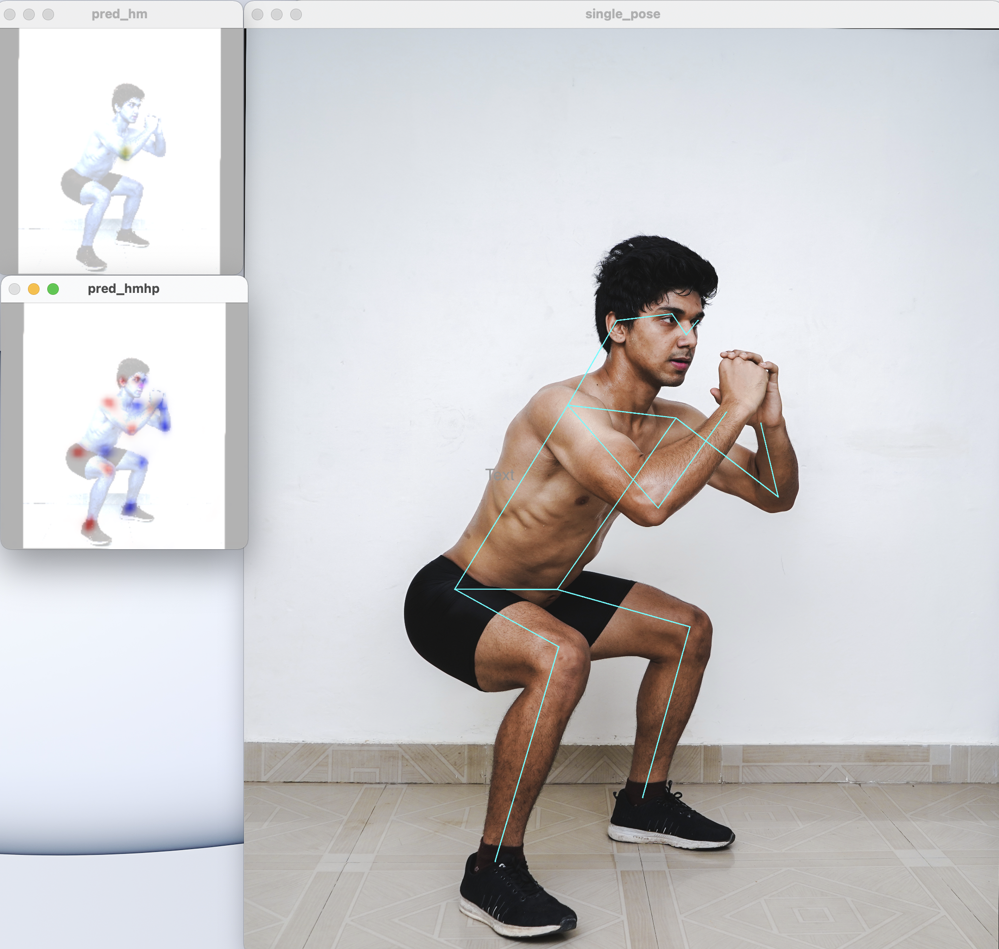
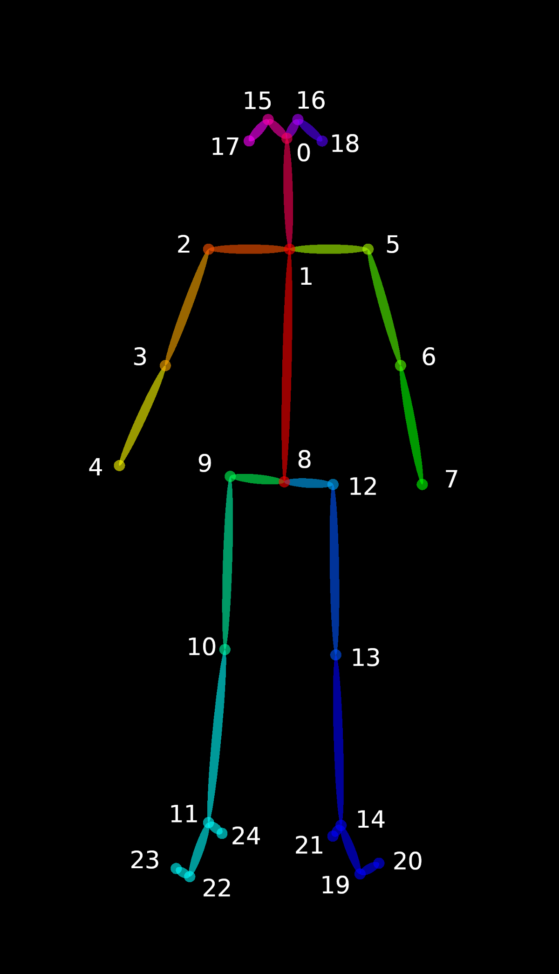

HUMAN POSTURE RECOGNITION AND CLASSIFICATION SYSTEM
29-12-22

Slide 2

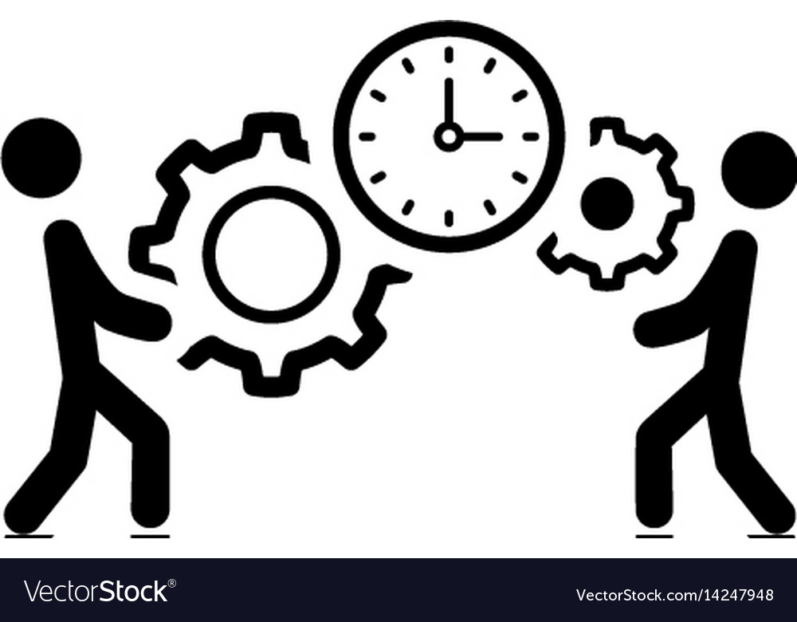
Project Outline
You may have heard that good posture is essential for good health, but do you know why? Posture refers to how you position your body when you’re sitting, standing, or lying down. Your posture is the result of habits formed over the course of years. Most of us sit when we are working, often in front of a computer.
Many people may recognize poor posture in others without realizing how their own falls short. This is where we come in action……
Posture detection and recognition in an automated way has great scope in many fitness applications and can sometimes replace the presence of a physiotherapist.
We propose a client server architecture where the users can correct posture , seek health benefits of a specific posture and also have an immersive experience with the application’s UI.

Slide 3
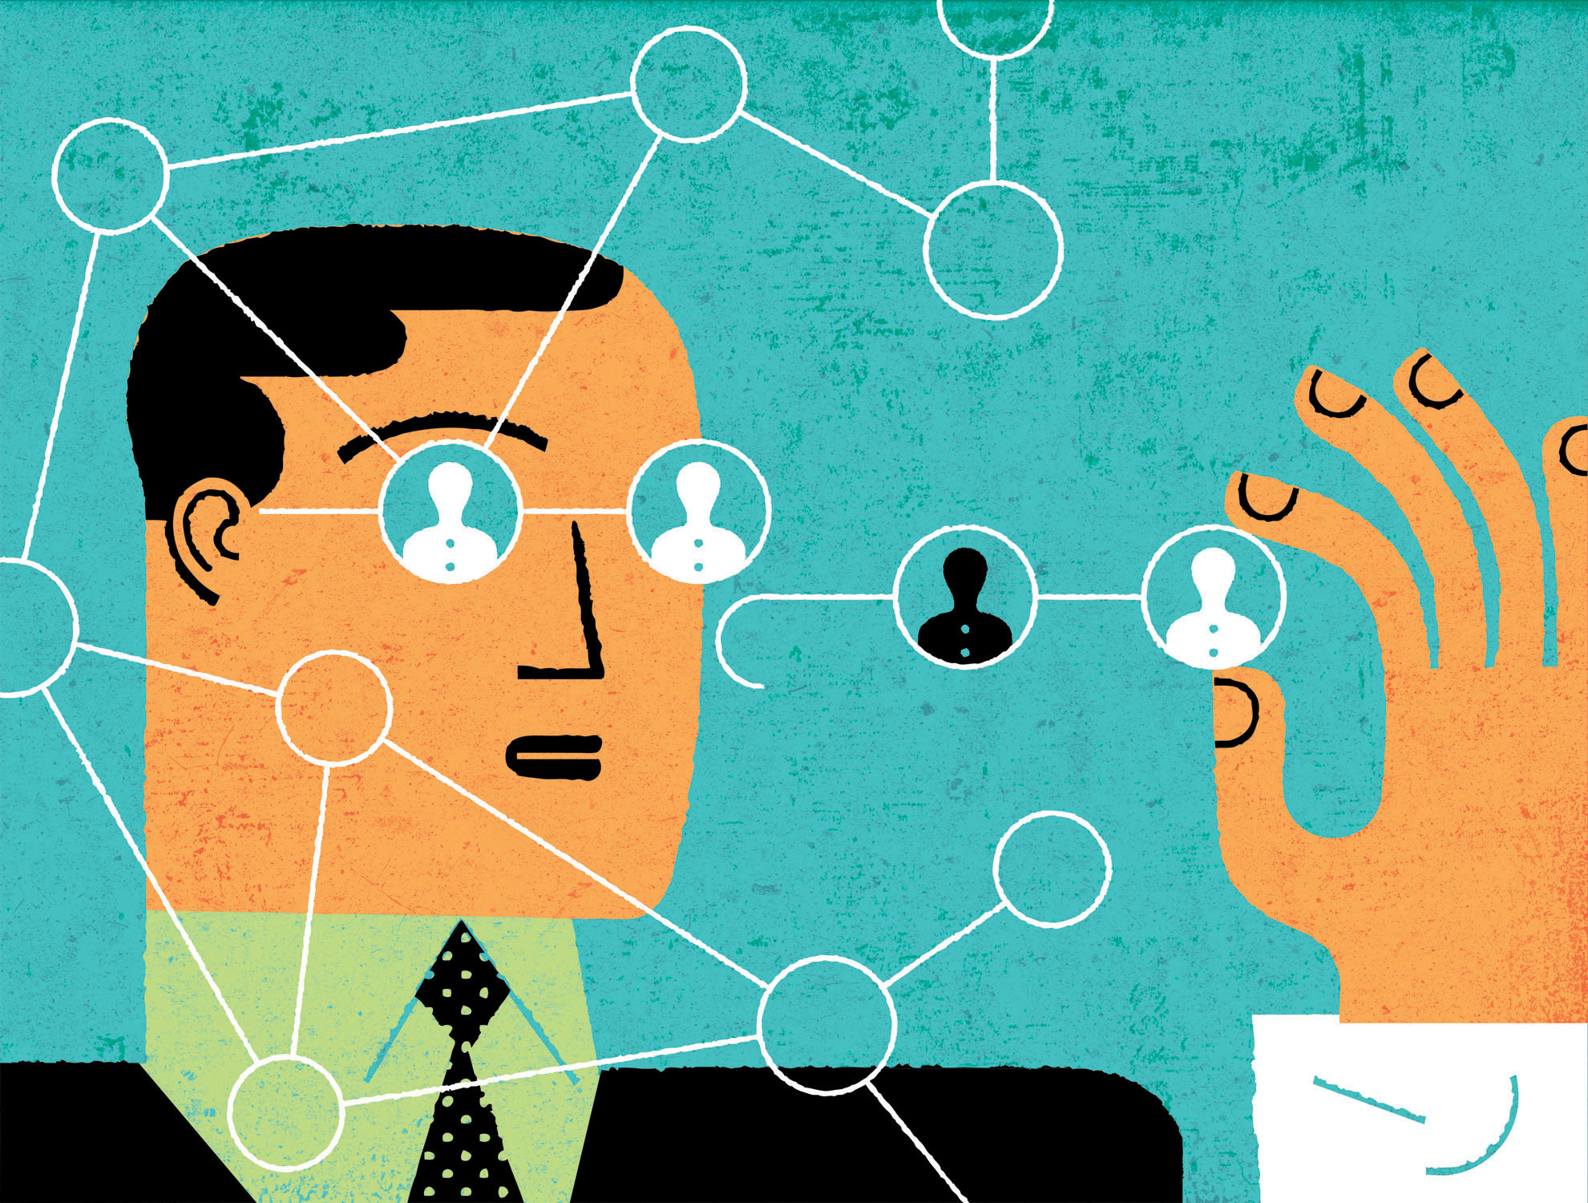
Index
Introduction and Abstract
Business Use Case
Important Use Case
Concepts Used
Our Data
Data Processing
Algorithm Used and Model
Optimal Case
Final Recommendations and Challenges Faced
Our Learning and Future Enhancements
Demo

Slide 4
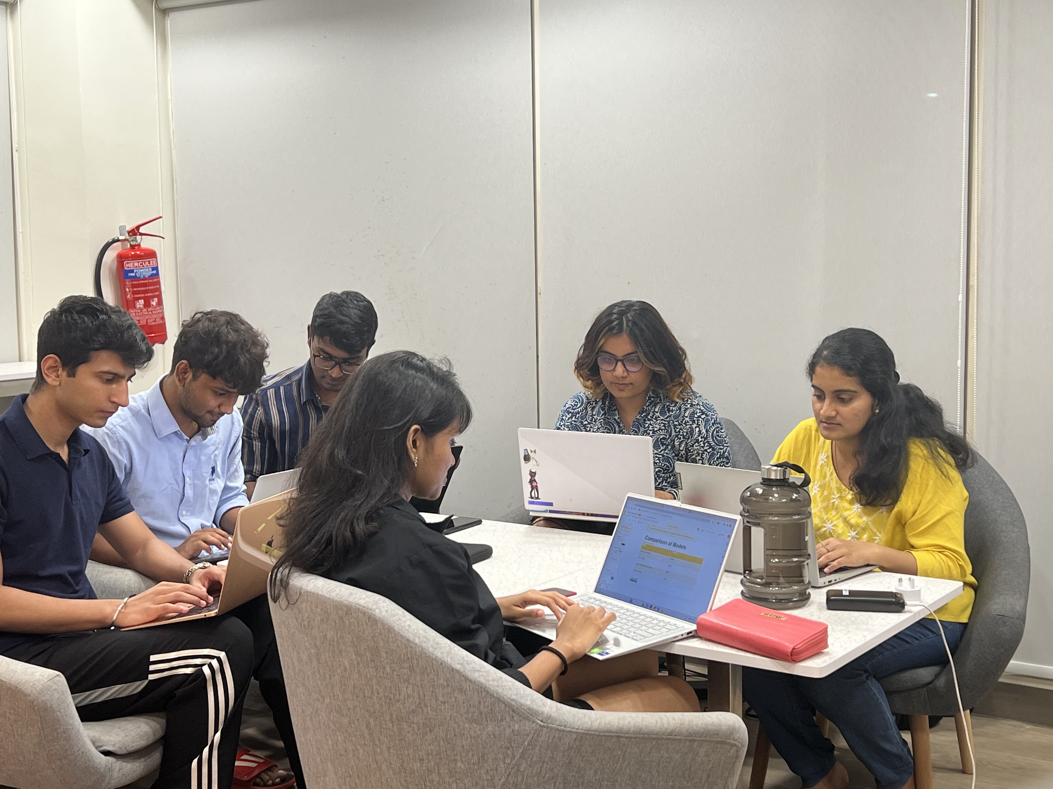
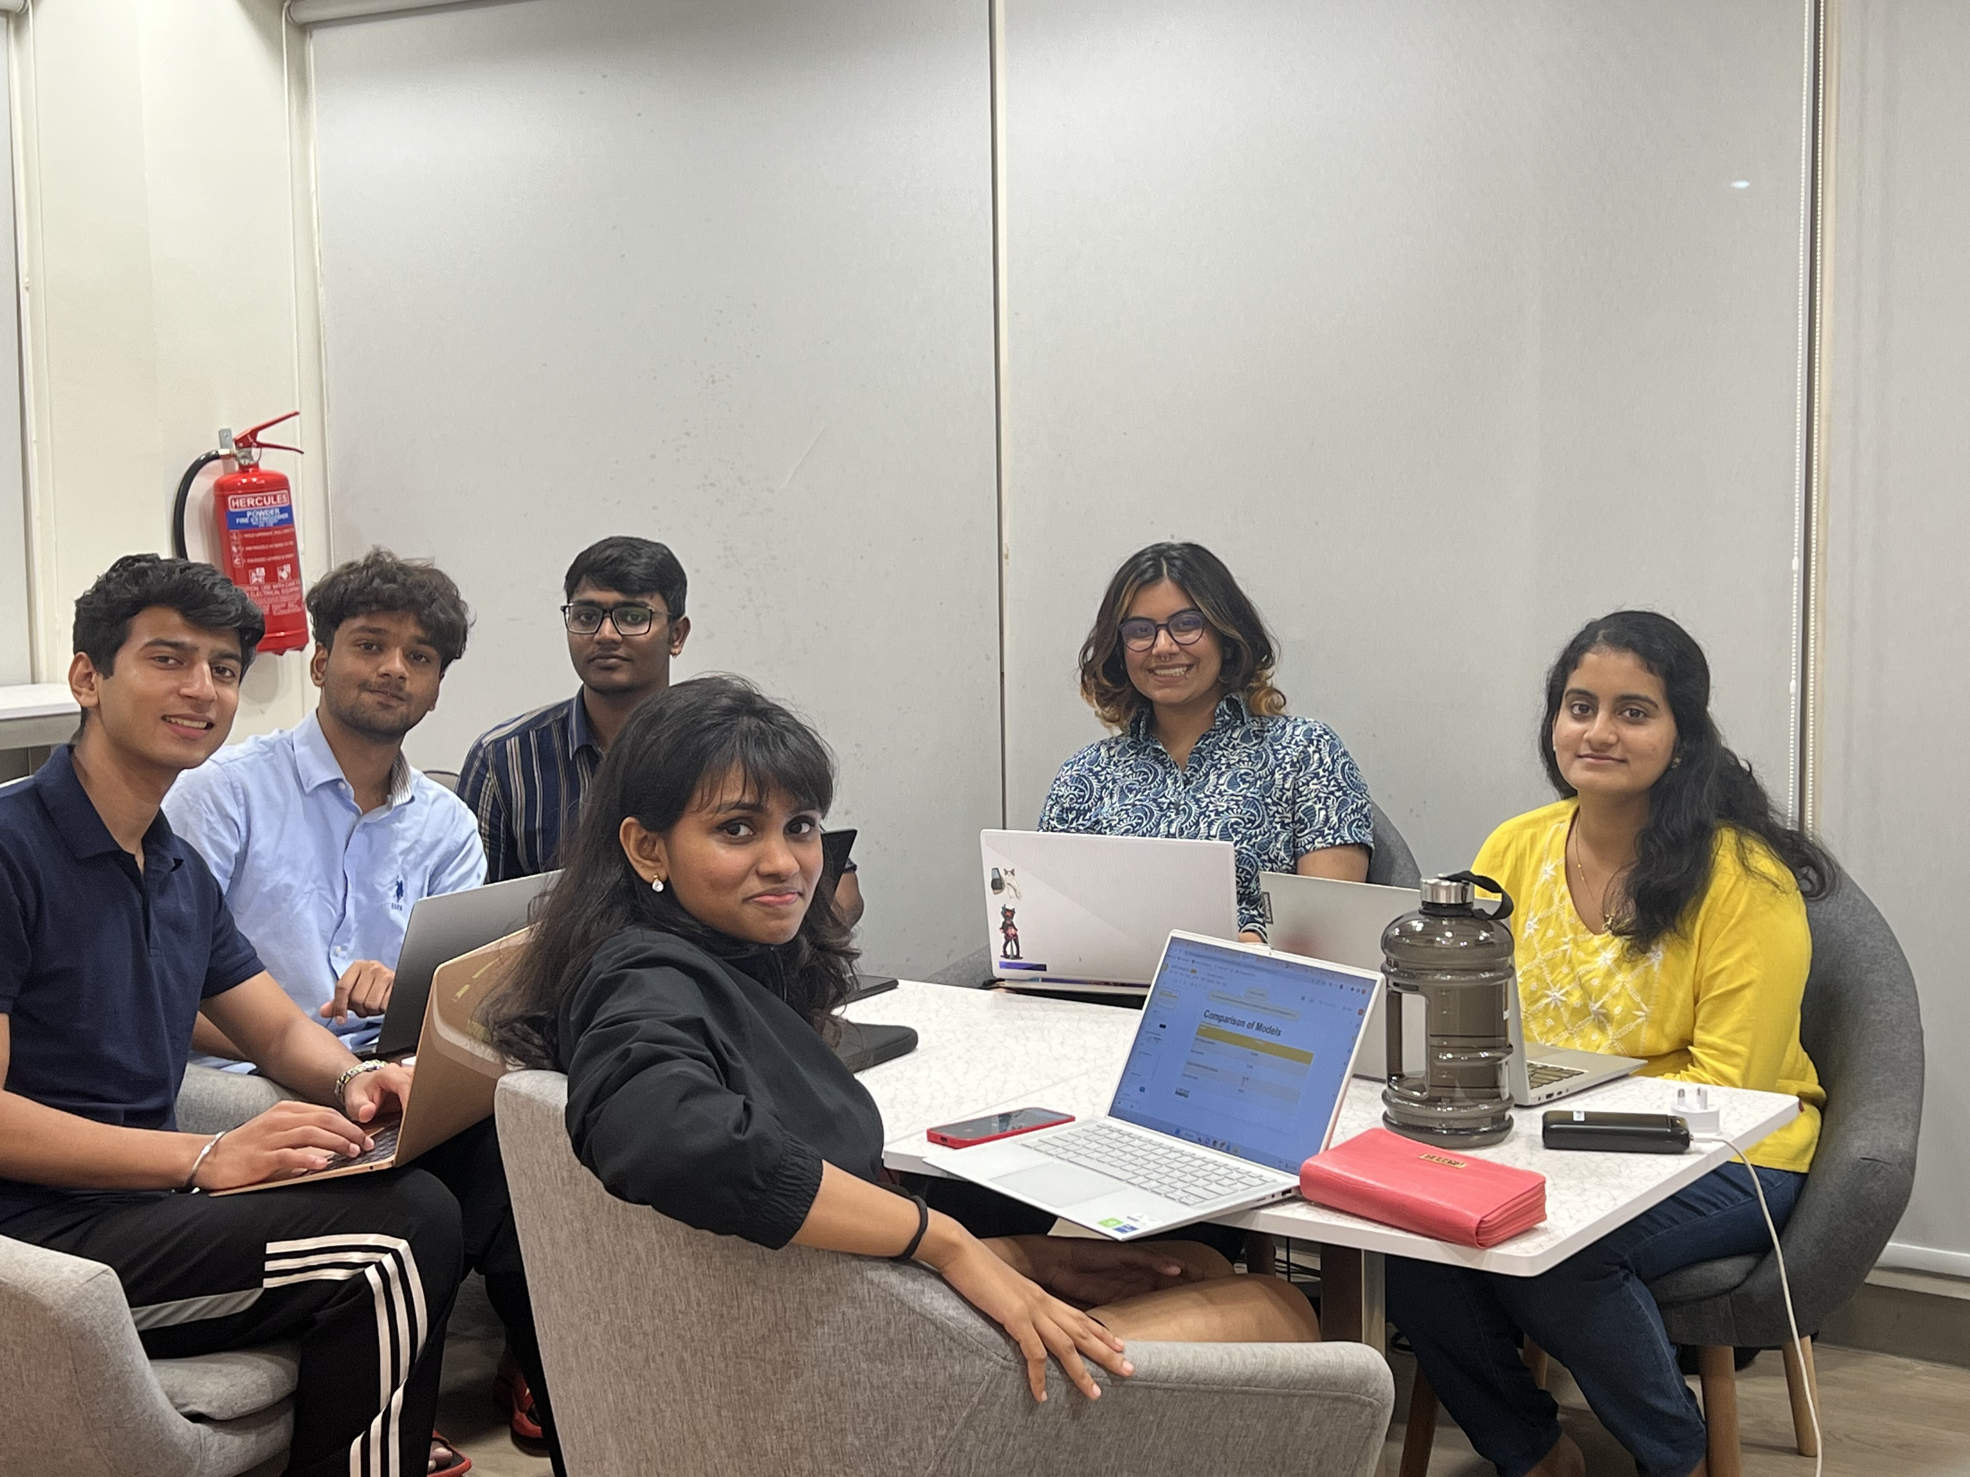
We the Team!
Anmol Singh Gill
Esha Hooda
Sree Reshma Paramel
Sriraja Vignesh S
Swathi S
Vinu Kevin Diesel S
Documentation, Business plan
Data collection and preprocessing , Model Deployment, Business plan
Optimization of models
Frontend UI , Model selection ML Initial prototyping and training
Model selection , training and comparison of 5 models
Data collection and Deployment

Slide 5
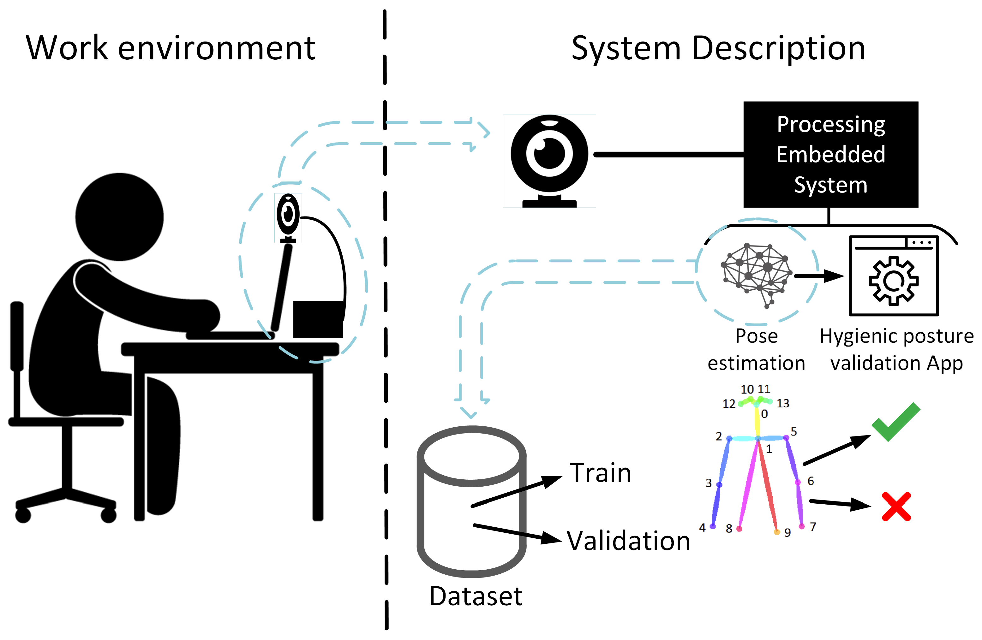
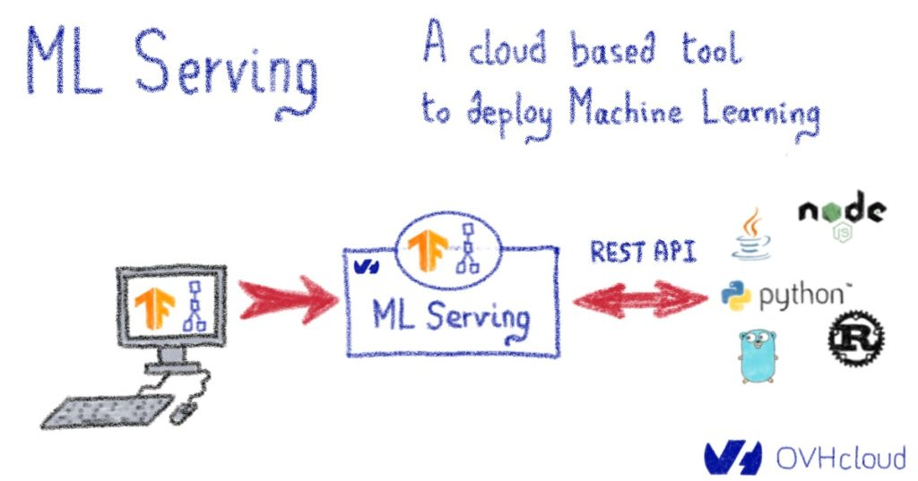
What we are trying to build?
A deep learning model which can process images, extract features of the image, draw a feature map and classify different postures by also suggesting the benefits, risks of staying at a particular posture for a long span of time.
A rule based chatbot which uses a tree-like flow to instead of AI to help guests with their queries.
The chatbot will guide the guest with follow-up questions to eventually get to the correct resolution.
An end-to-end application which can classify postures, correct the postures and give active suggestions throughout the routine.
DEEP LEARNING MODEL

Slide 6

Abstract
This project is intended to identify the incorrect posture of a human and also suggest corrective measures. As standing in a wrong posture for too long might result in many health problems such as backpain, soreness around the neck region, poor circulation of blood and also affects the eyesight in the long run. The aforementioned model takes in images of the users in the standing position as the input and uses MoveNet framework to extract features (17 points, i.e, wrist, shoulder, elbow, etc ) of the image. Further, it uses various machine learning models and neural networks to classify the input image's posture into three classes which are squat, sidebend and standing (Correct posture). The whole model is then converted to Tensor flow lite as it is light weight and could easily be used to deploy the model in a server. Finally, If the resultant posture is anything other than the standing posture is termed as incorrect and a rectification measure will be suggested accordingly.

Slide 7

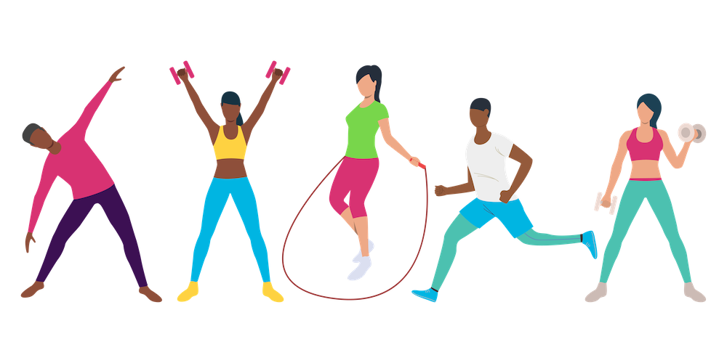
Business Use Case
There are many potential business use cases present in this project which one could use to monetize.
Our prime target is the Health and Fitness industry.
This market is estimated to grow at a rate of 7.67 percent annually between 2023 and 2030. By 2030, this industry is estimated to be worth approximately 169.7 billion U.S. dollars.
This system could be integrated in the gyms by further enhancing our model such that it takes input via video so that people could be aware of their posture

Slide 8

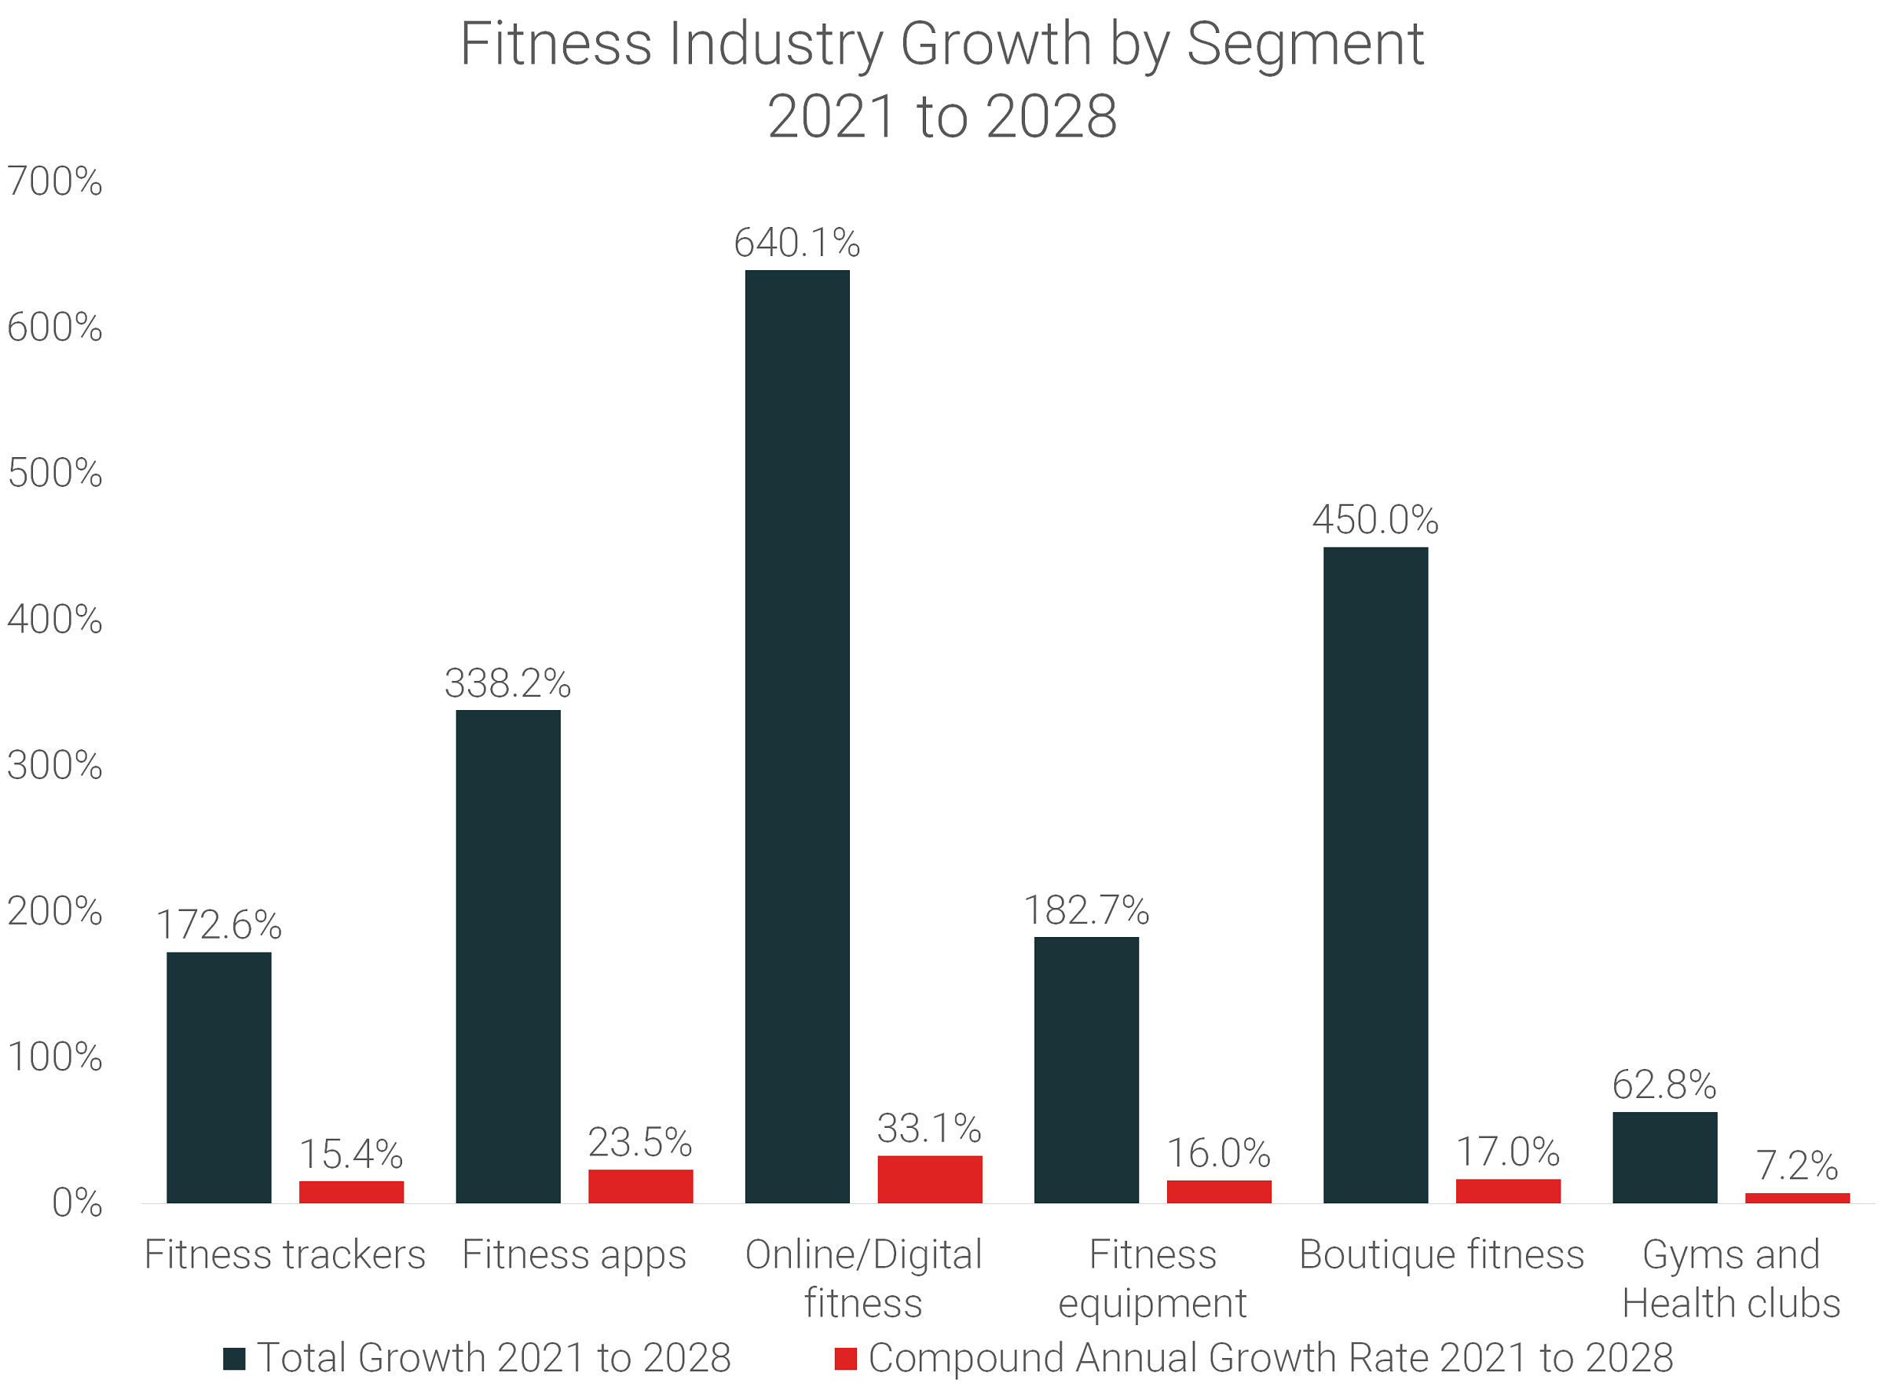
For general public we will bring up a freemium model in which some limited features will be available to them for free use but they will have to pay some amount in the form of a subscription in order to access the premium features of the system .
Now comes our cost. For any business there are some initial setting costs , maintenance costs and operation costs. Thats where cloud comes in. It helps to cut all additional costs , thus we only pay for the cloud service.
OUR COST---> 9.9 + 36.43 = 46.33SGD/MONTH
Google Colab Pro
Microsoft Azure

Slide 9


Continued…
Spinal cord related areas surgeries, simulation models etc. expected to grow at ~9% by 2026 reaching 3.2 USD.
Postural defects cause spinal cord injuries which further cause disabilities so the model is also relevant to the disability prevention sector.
Relates with big sectors, hence, we will also open the project to investors and MNCs like maxhealth.

Slide 10
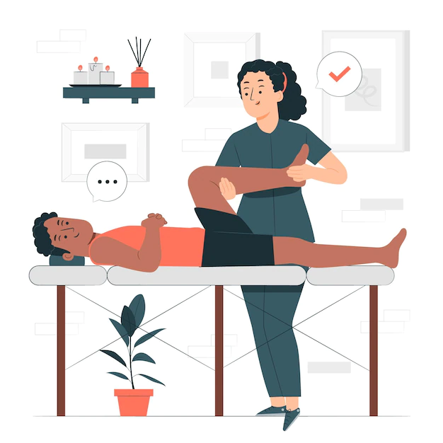
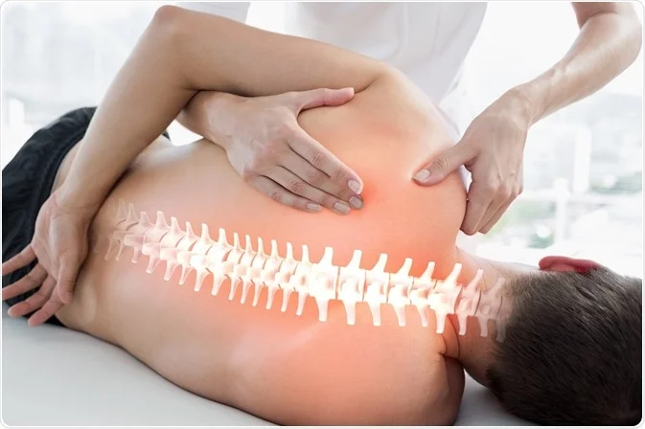
Important Use Case
The application replaces the presence of a physiotherapist by detecting the posture, providing active suggestions to come back to a good posture which ensures the postural integrity of the spine.
It Helps cut down on the wear and tear of joint surfaces (such as the knee) to help prevent the onset of arthritis.
Decreases strain on the ligaments in the spine reducing the risk of ligament tear.
Provides immersive learning experience of self-management techniques to reduce the chance of injury reoccurrence.

Slide 11
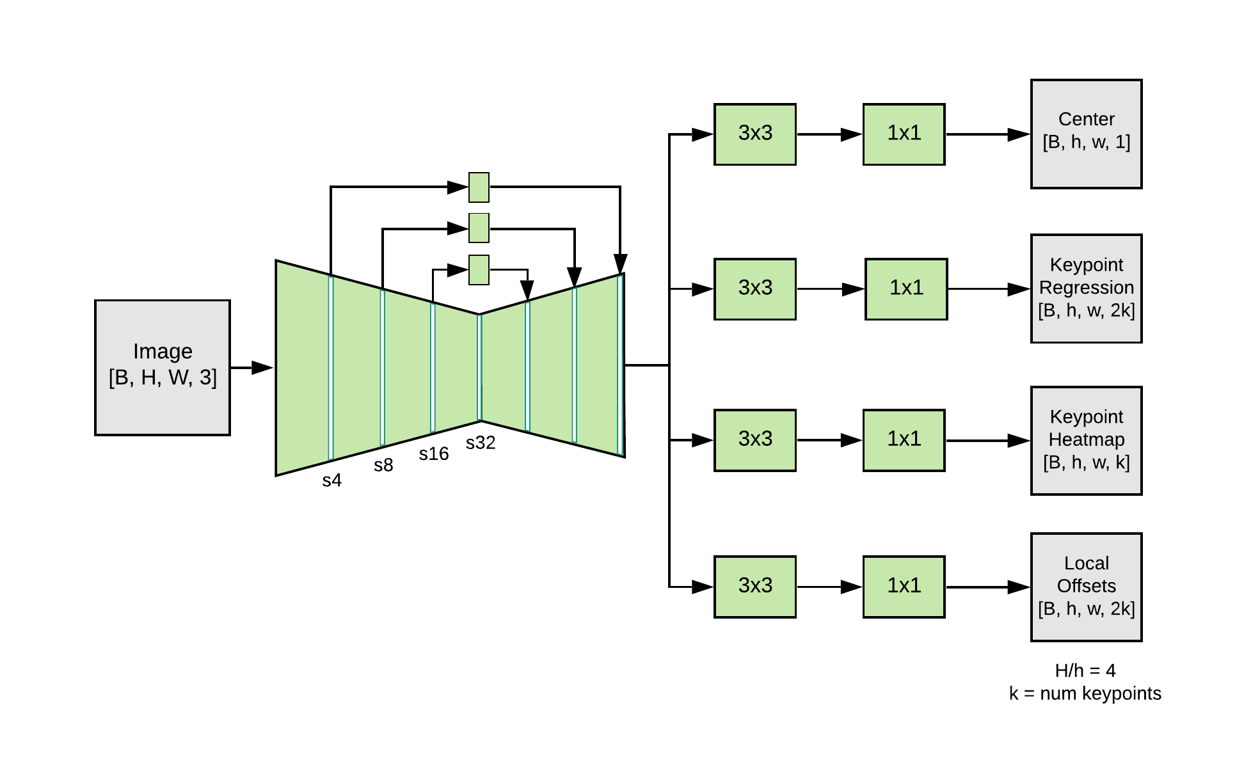
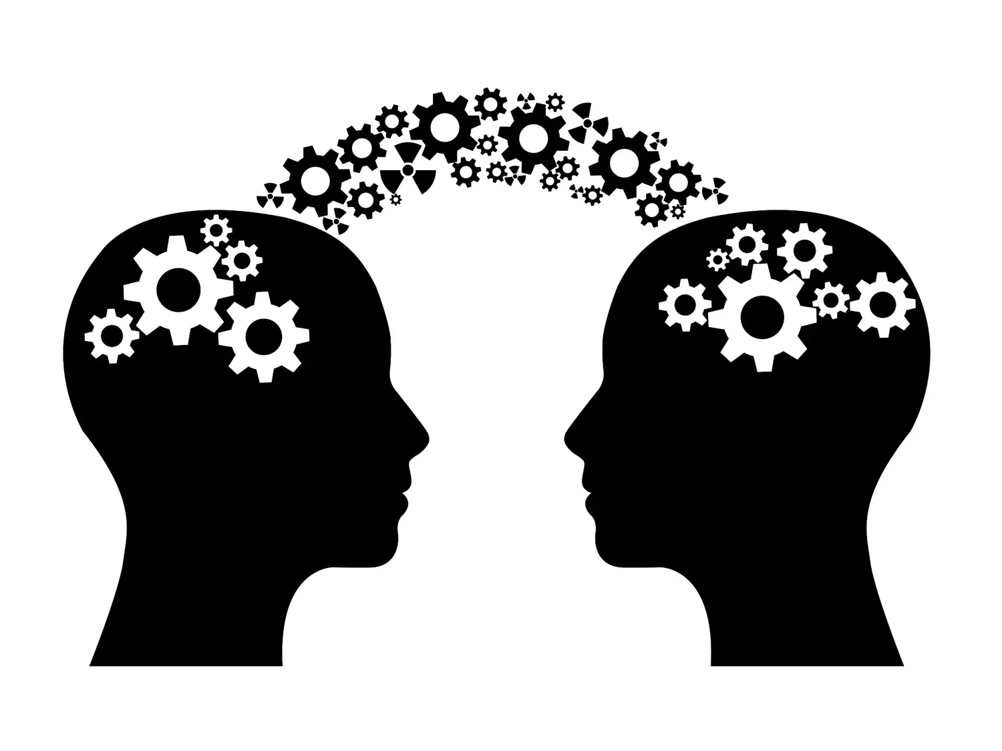
Concepts Used
Transfer learning: Transfer learning is the application of knowledge gained from completing one task to help solve a different, but related, problem.
Movenet : MoveNet, with our new pose-detection API in TensorFlow.js and is an ultra fast and accurate model that detects 17 key points of a body. The model we used here is Move Net Thunder that is intended for applications that require high accuracy.
Neural Network: There are 4 layers in the model for classification which is built on top of Keras.
Scikit learn: The machine learning library used to split the dataset into training , testing and validation.
Data pre processing: Pre processing of the data using Robo flow platform.
Class labels: The number of class labels are 3 which includes standing, squatting and sidebend.

Slide 12
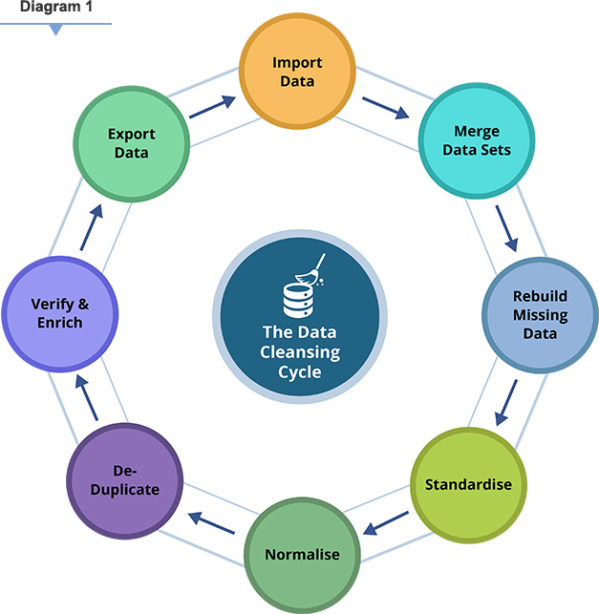
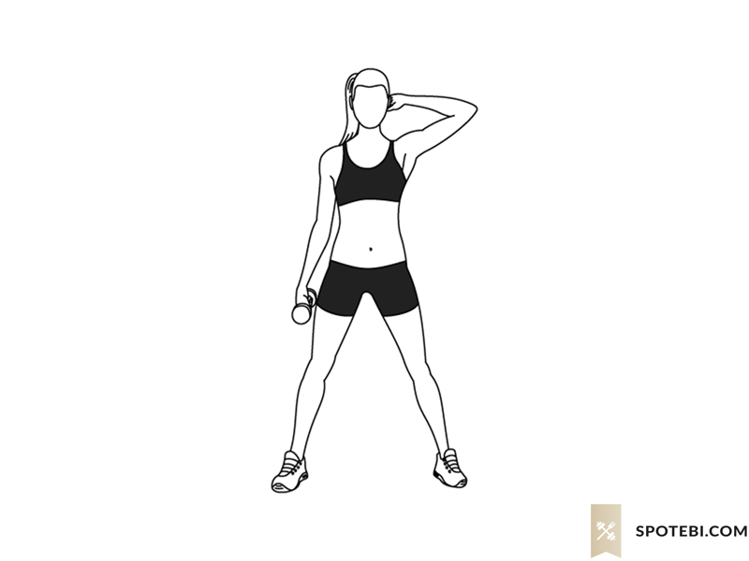
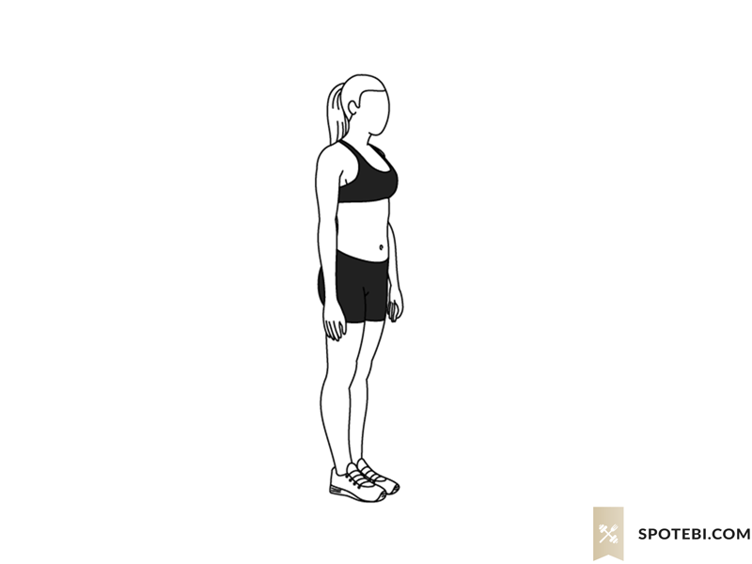
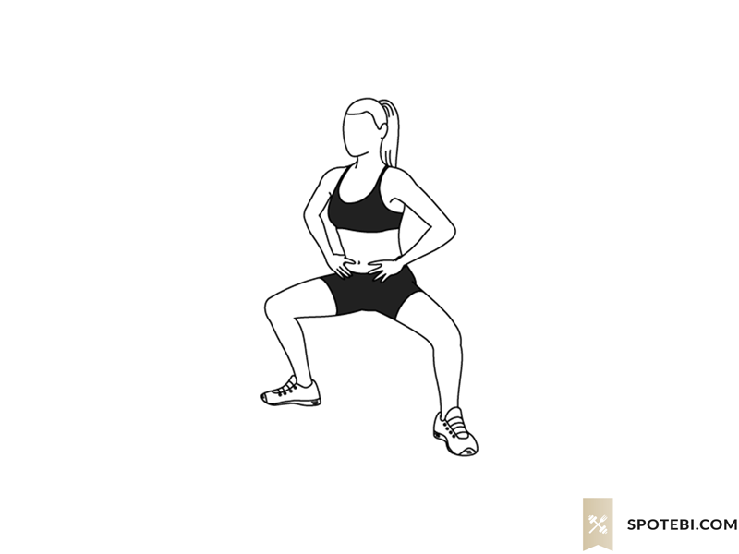
Our Data
Model predicts the posture of an image of a person
3 classes in total, namely Side Bend , Standing and Squatting
Two decisions to be made: proper or improper standing posture
Collected roughly 330 images per class
Collected images manually for cleaner data
Ended up with 220 images per class for training, 30 images per class for testing, and 60 images per class for validation.

Slide 13


How we Processed Data
Used a tool called Roboflow to build a good dataset
Annotated images and checked their quality
Cropped them as per our needs, for example, background should be mute
Split and kept 70% data for training, 20% for testing, and 10% for validation using train_test_split from scikit-learn
library.

Slide 14

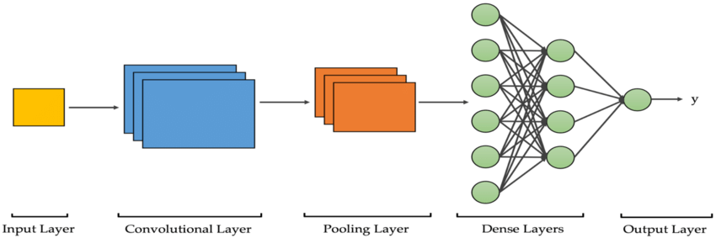
Algorithm Used
Algorithm to convert the pose landmarks to a pose embedding (a.k.a feature vector) for pose classification.
Additional functions to convert the landmark coordinates to a feature vector by:
1.Moving the pose center to the origin.
2.Scaling the pose so that the pose size becomes 1.
3.Flattening these coordinates into a feature vector.
The algorithm uses this feature vector to train a neural-network based pose classifier.
Calculates the center point of the two given landmarks, pose size.
Pose size is calculated by taking maximum of two values which are torso size, maximum distance from pose center to any pose landmark.
Converts the input landmarks into a pose embedding.

Slide 15
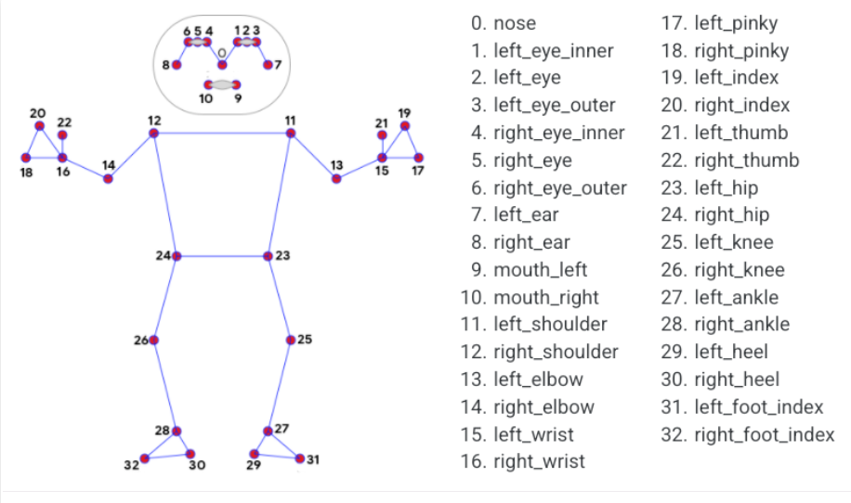
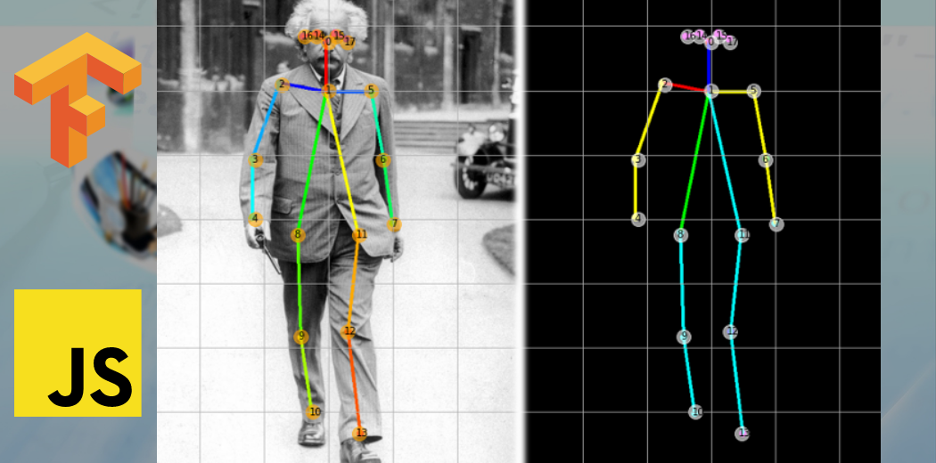
Continued
The pose classification model is done using pre-built layers of Keras and additional layers of the neural network are added with dropout rates in between to significantly reduce the number of neurons.
The feature vectors of the model is typically pose embeddings, pose landmarks and is trained by modifying the hyperparameters.

Slide 16
Comparison of Models
Model | Accuracy
Naïve Bayes Classifier | 82.86%
MLP Classifier | 81.8%
Support Vector Machine Classifier | 86.3%
Move net model | 98.6%

Slide 17
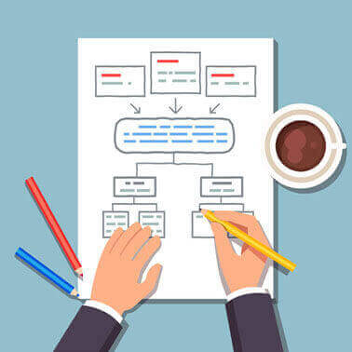
Optimal Case
Out of all the 4 classification models, Move net architecture gave the highest accuracy being a neural network architecture performing a classification task.
MoveNet is an ultra fast and accurate model that detects 17 keypoints of a body. The model is offered on TFHub with two variants, known as Lightning and Thunder.
We have implemented Lightning for our end-to-end application since it is latency critical.
Move net Thunder is intended for applications that require high accuracy.
Both models run faster than real time (30+ FPS) on most modern desktops, laptops, and phones, which proves crucial for live fitness, health, and wellness applications.
This model runs equally well with image as well as video data samples.

Slide 18

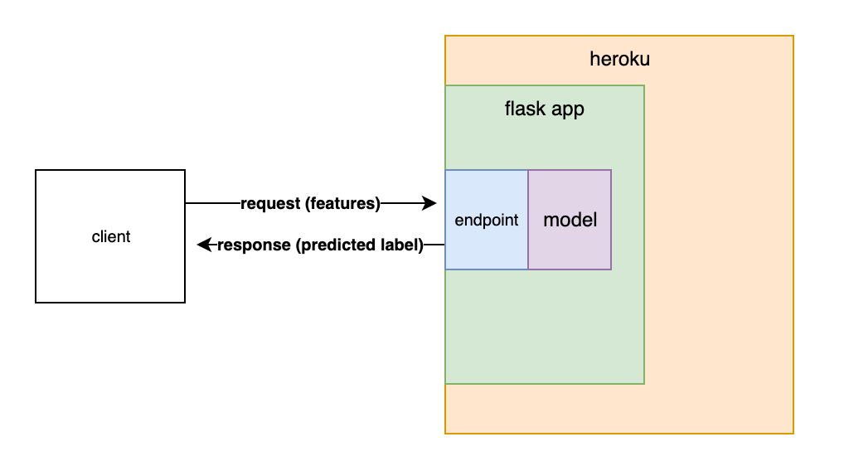
Diagram(s) or Visualization(s)

Slide 19

FINAL RECOMMENDATIONS
In order to retain the accuracy of the model, conversion from tensorflow to .tflite model is prevented by retaining the output tensor dimensions.
Hyperparameter tuning should be done for more parameters.
Deployment of the model into Kubernetes.

Slide 20
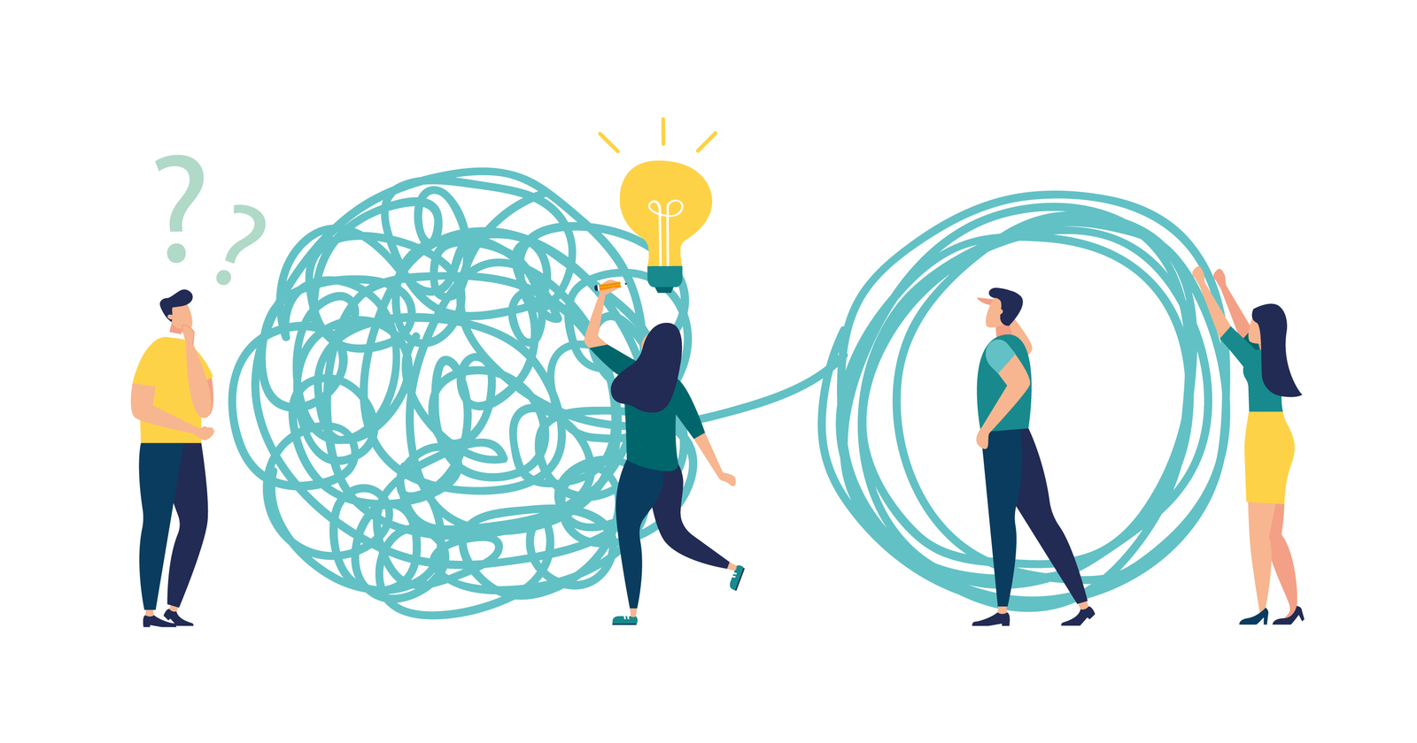

Challenges Faced
Inadequate Data: It was impossible to find a curated publicly available dataset which consisted of images and with the initial 500 images we scrapped manually using semi automated scraping with python scripts gave testing accuracy of 76% with a overall loss of 0.53
Dimension mismatch: The size of quantized tensor flow lite model didn’t match with the flask application’s re sizeable parameters. We had to compress the model dimensions and had to compress in order for it to fit. .
Conversion of data types in Flask: The conversion of base64 to string for getting images in the server posed difficulty.The conversion of base64 to string for getting images in the server posed difficulty. Base64 encoding is usually used to convert binary data to string format.
Deploying the model: The model was initially 64KB and issues with latency, rendering time was prevelant.
Fine-tuning the hyperparameters: - Hyperparameters can be fine-tuned or adjusted for better accuracy and results. It is basically done in order to find the best combination to handle your problem.

Slide 21

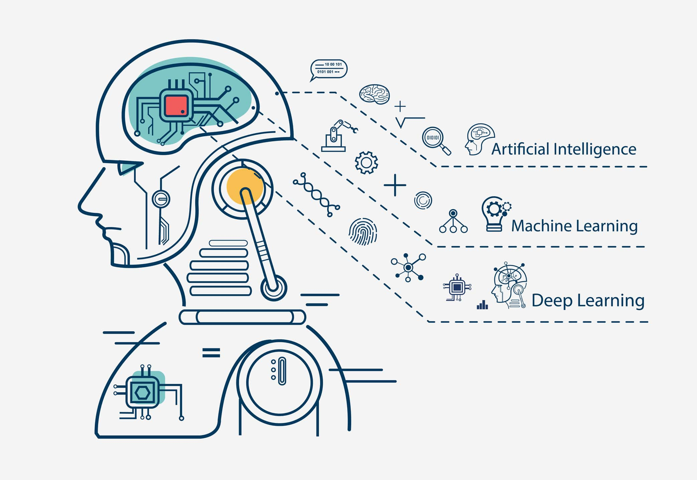
Our Learning
We learnt the key difference between the usual Machine learning models and the neural networks and also observed the performance boost in the use of neural networks during the classification aspect of the posture correction system. The key difference is in the way of understanding the data and finding patterns. The machine learning models simply analyze the data which is fed and figure out the patterns using algorithms which uses data mining and statistical analysis, whilst a deep learning technique learns categories incrementally through it’s hidden layer architecture, defining low-level categories like letters first then little higher level categories like words and then higher level categories like sentences.
For the Posture correction system, the best machine learning model was the SVM (support vector machine) which gave an accuracy of 80% but with the same amount of data, The CNN (convolution neural networks) deep learning model gave an accuracy of 98%, thus we can clearly see that, CNN performs much better at classification than the SVM model.

Slide 22
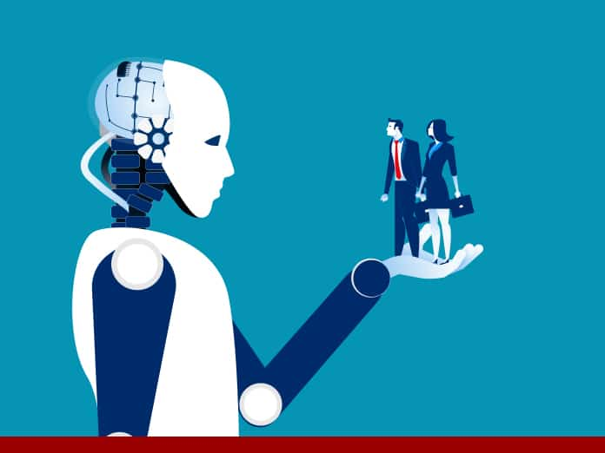
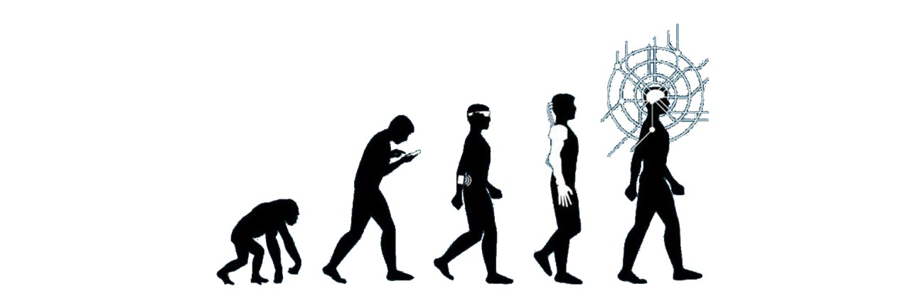
Future Enhancements
Inclusion of more classes making the multi label classification more diverse as well as bringing diversity of poses.
Introducing inception v3 for feature extractor for better classification results.
Inclusion of suggestions on near by hospitals to visit based on google maps API.
Incorporating better healthcare suggestions by processing real time videos along with images.
Reducing or optimizing the performance of the application by reducing the size of the .tflite model.

Slide 23
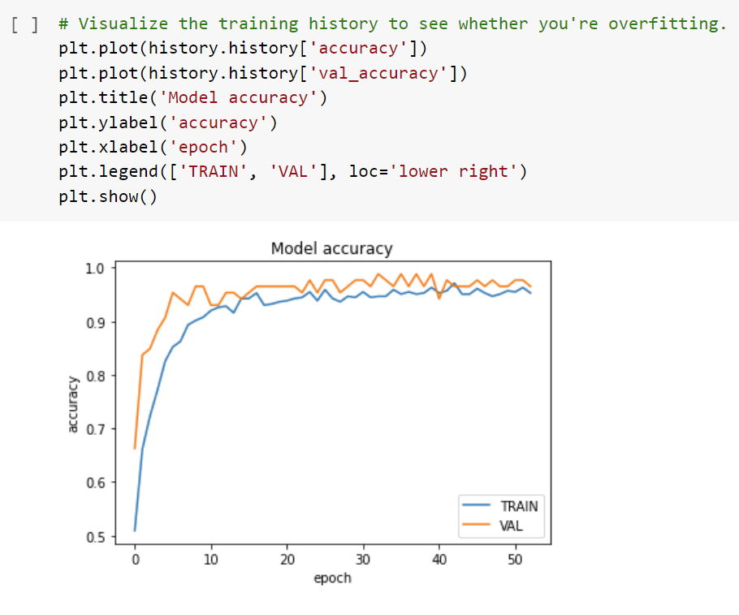
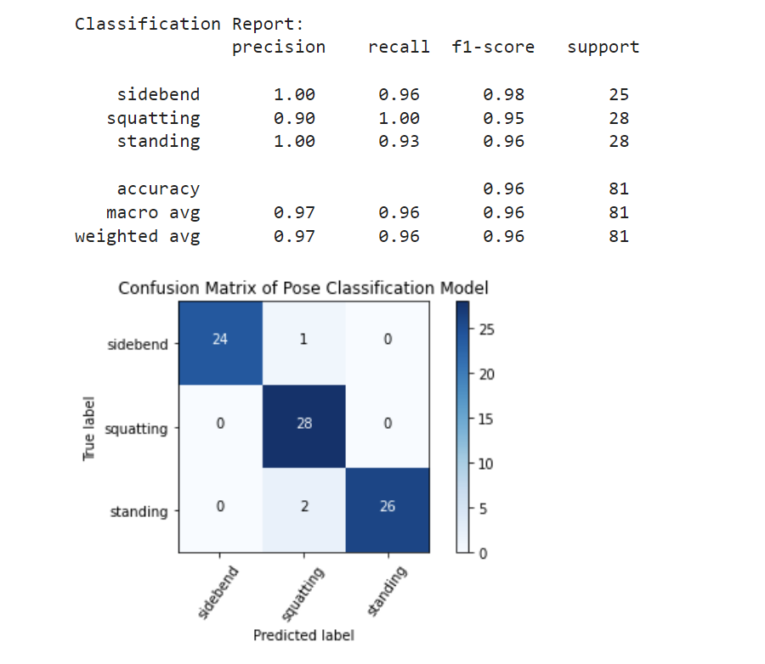
Demo

Slide 24
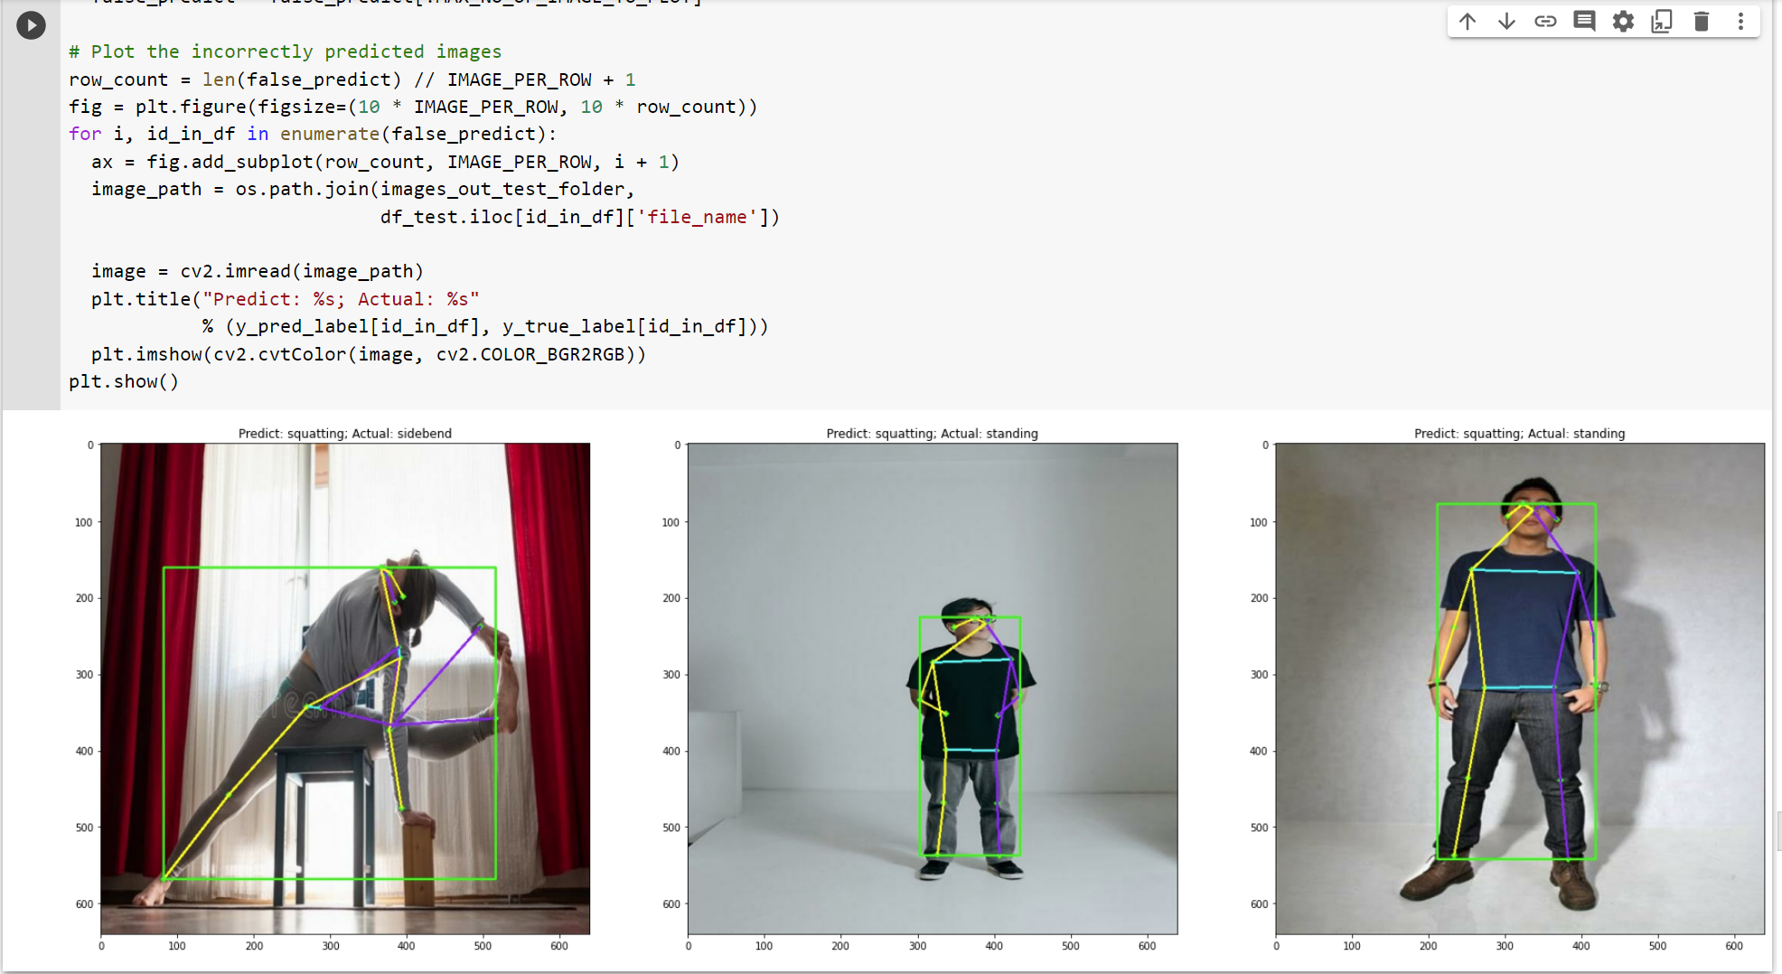
Demo

Slide 25
Thank You

